Slide 1

STARTING OUT WITH C++
9th Edition
Chapter 13
Introduction to Classes

Slide 2
13.1
Procedural and Object-Oriented Programming

Slide 3
Procedural and Object-Oriented Programming
Procedural programming focuses on the process/actions that occur in a program
Object-Oriented programming is based on the data and the functions that operate on it. Objects are instances of ADTs that represent the data and its functions

Slide 4
Limitations of Procedural Programming
If the data structures change, many functions must also be changed
Programs that are based on complex function hierarchies are:
  difficult to understand and maintain
  difficult to modify and extend
  easy to break

Slide 5
Object-Oriented Programming
Terminology
class: like a struct (allows bundling of related variables), but variables and functions in the class can have different properties than in a struct
object: an instance of a class, in the same way that a variable can be an instance of a struct

Slide 6
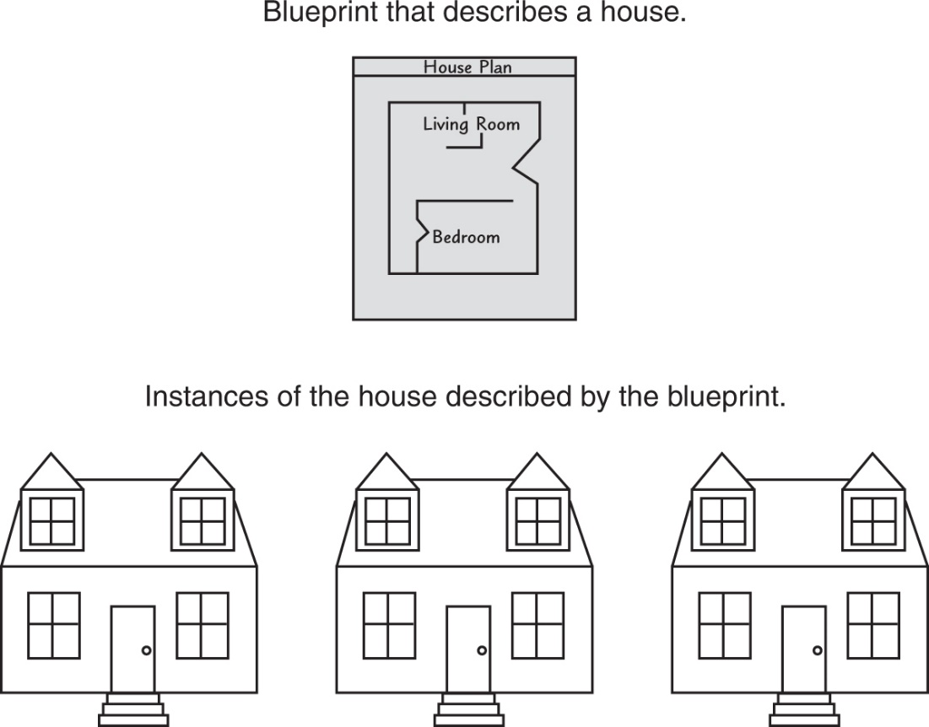
Classes and Objects
A Class is like a blueprint and objects are like houses built from the blueprint

Slide 7
Object-Oriented Programming
Terminology
attributes: members of a class
methods or behaviors: member functions of a class

Slide 8
More on Objects
data hiding: restricting access to certain members of an object
public interface: members of an object that are available outside of the object. This allows the object to provide access to some data and functions without sharing its internal details and design, and provides some protection from data corruption

Slide 9
13.2
Introduction to Classes

Slide 10
Introduction to Classes
Objects are created from a class
Format:
  class ClassName
  {
  declaration;
  declaration;
  };

Slide 11
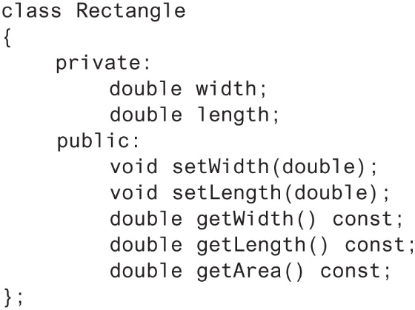
Class Example

Slide 12
Access Specifiers
Used to control access to members of the class
public: can be accessed by functions outside of the class
private: can only be called by or accessed by functions that are members of the class

Slide 13
Class Example
Private Members
Public Members

Slide 14
More on Access Specifiers
Can be listed in any order in a class
Can appear multiple times in a class
If not specified, the default is private

Slide 15
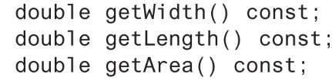
Using const With Member Functions
const appearing after the parentheses in a member function declaration specifies that the function will not change any data in the calling object.

Slide 16
Defining a Member Function
When defining a member function:
  Put prototype in class declaration
  Define function using class name and scope resolution operator (::)
    int Rectangle::setWidth(double w)
    {
    width = w;
    }

Slide 17
Accessors and Mutators
Mutator: a member function that stores a value in a private member variable, or changes its value in some way
Accessor: function that retrieves a value from a private member variable. Accessors do not change an object's data, so they should be marked const.

Slide 18
13.3
Defining an Instance of a Class

Slide 19
Defining an Instance of a Class
An object is an instance of a class
Defined like structure variables:
  Rectangle r;
Access members using dot operator:
  r.setWidth(5.2);
  cout << r.getWidth();
Compiler error if attempt to access private member using dot operator

Slide 20
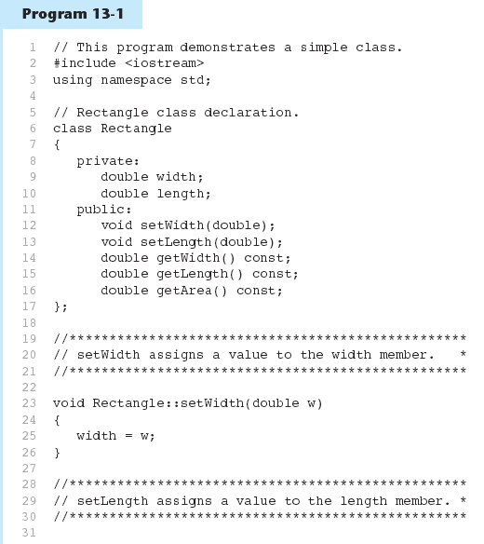

Slide 21
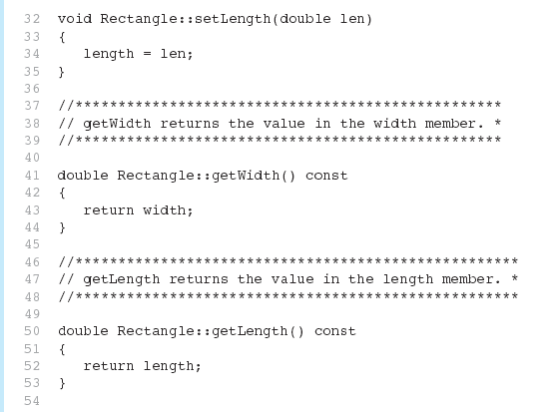
Program 13-1 (Continued)

Slide 22
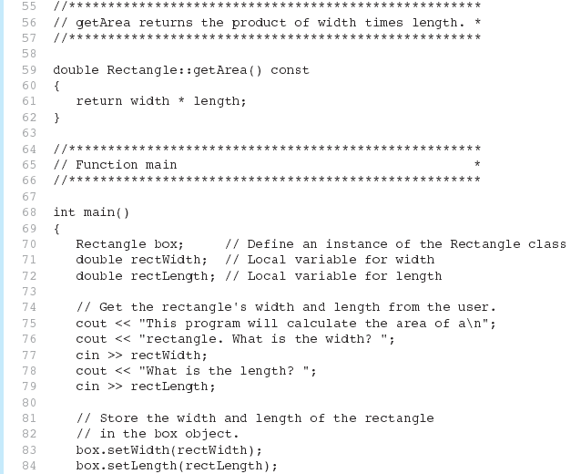
Program 13-1 (Continued)

Slide 23
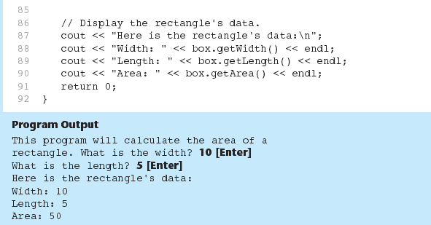
Program 13-1 (Continued)

Slide 24
Avoiding Stale Data
Some data is the result of a calculation.
In the Rectangle class the area of a rectangle is calculated.
  length x width
If we were to use an area variable here in the Rectangle class, its value would be dependent on the length and the width.
If we change length or width without updating area, then area would become stale.
To avoid stale data, it is best to calculate the value of that data within a member function rather than store it in a variable.

Slide 25
Pointer to an Object
Can define a pointer to an object:
  Rectangle *rPtr = nullptr;
Can access public members via pointer:
  rPtr = &otherRectangle;
  rPtr->setLength(12.5);
  cout << rPtr->getLength() << endl;

Slide 26
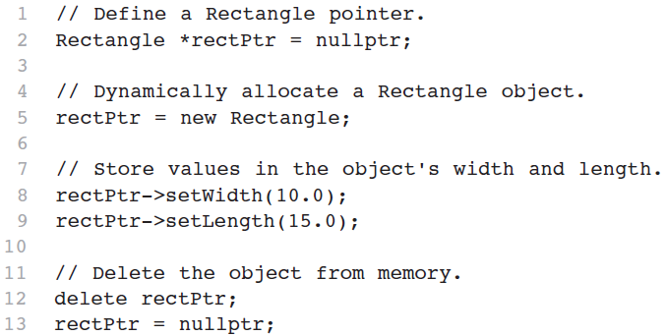
Dynamically Allocating an Object
We can also use a pointer to dynamically allocate an object.

Slide 27
13.4
Why Have Private Members?

Slide 28
Why Have Private Members?
Making data members private provides data protection
Data can be accessed only through public functions
Public functions define the class’s public interface

Slide 29
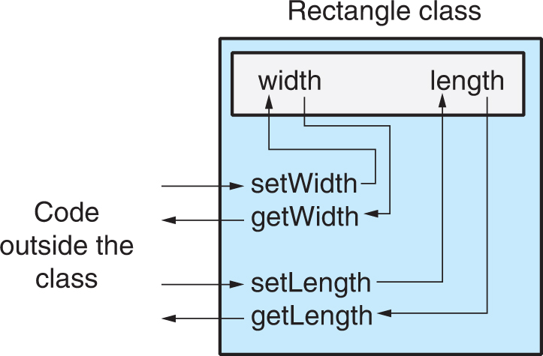
Code outside the class must use the class's public member functions to interact with the object.

Slide 30
13.5
Separating Specification from Implementation

Slide 31
Separating Specification from Implementation
  Place class declaration in a header file that serves as the class specification file. Name the file ClassName.h, for example, Rectangle.h
  Place member function definitions in ClassName.cpp, for example, Rectangle.cpp File should #include the class specification file
  Programs that use the class must #include the class specification file, and be compiled and linked with the member function definitions

Slide 32
13.6
Inline Member Functions

Slide 33
Inline Member Functions
Member functions can be defined
  inline: in class declaration
  after the class declaration
Inline appropriate for short function bodies:
  int getWidth() const
  { return width; }

Slide 34
Rectangle Class with Inline Member Functions
1 // Specification file for the Rectangle class
2 // This version uses some inline member functions.
3 #ifndef RECTANGLE_H
4 #define RECTANGLE_H
5
6 class Rectangle
7 {
8 private:
9 double width;
10 double length;
11 public:
12 void setWidth(double);
13 void setLength(double);
14
15 double getWidth() const
16 { return width; }
17
18 double getLength() const
19 { return length; }
20
21 double getArea() const
22 { return width * length; }
23 };
24 #endif

Slide 35
Tradeoffs – Inline vs. Regular Member Functions
Regular functions – when called, compiler stores return address of call, allocates memory for local variables, etc.
Code for an inline function is copied into program in place of call – larger executable program, but no function call overhead, hence faster execution

Slide 36
13.7
Constructors

Slide 37
Constructors
Member function that is automatically called when an object is created
Purpose is to construct an object
Constructor function name is class name
Has no return type

Slide 38
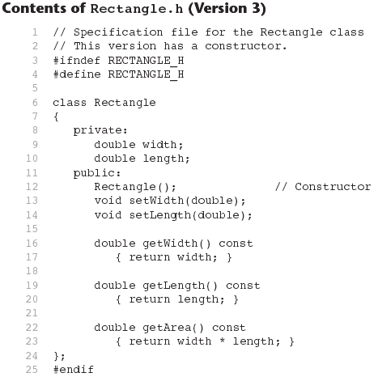

Slide 39
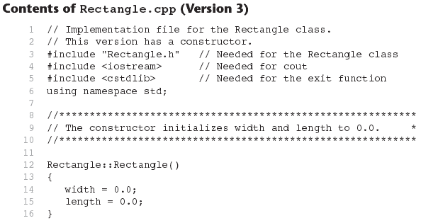
Continues...

Slide 40
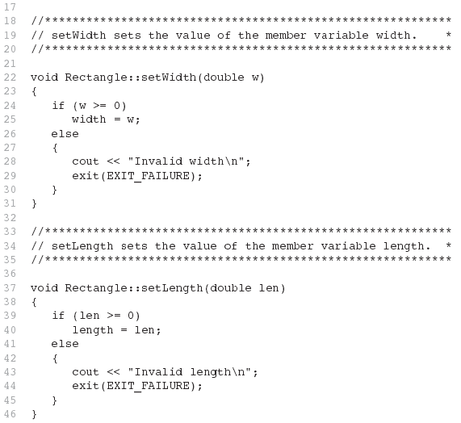
Contents of Rectangle.ccp Version3
(continued)

Slide 41
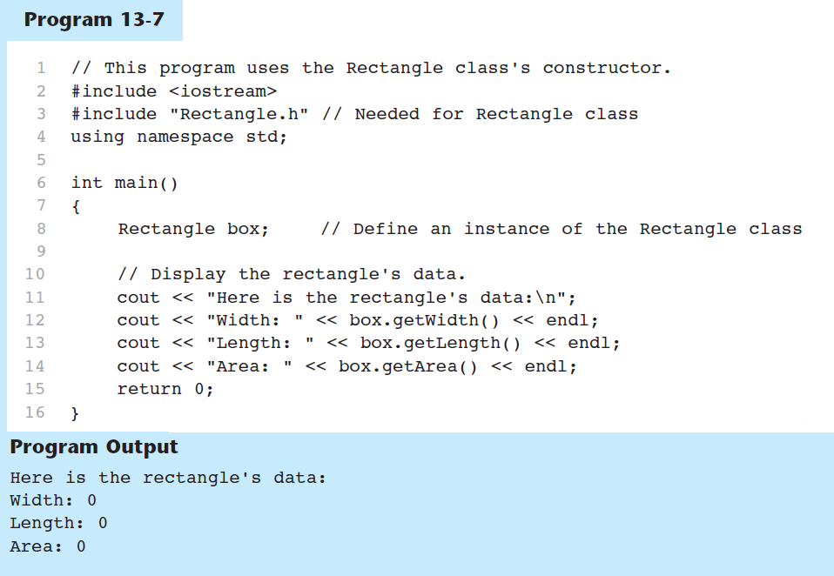

Slide 42
In-Place Initialization
If you are using C++11 or later, you can initialize a member variable in its declaration statement, just as you can with a regular variable.
This is known as in-place initialization. Here is an example:
class Rectangle
{
private:
double width = 0.0;
double length = 0.0;
public:
Public member functions appear here…
};

Slide 43
Default Constructors
A default constructor is a constructor that takes no arguments.
If you write a class with no constructor at all, C++ will write a default constructor for you, one that does nothing.
A simple instantiation of a class (with no arguments) calls the default constructor:
  Rectangle r;

Slide 44
13.8
Passing Arguments to Constructors

Slide 45
Passing Arguments to Constructors
To create a constructor that takes arguments:
  indicate parameters in prototype:
  Rectangle(double, double);
  Use parameters in the definition:
  Rectangle::Rectangle(double w, double len)
  {
  width = w;
  length = len;
  }

Slide 46
Passing Arguments to Constructors
You can pass arguments to the constructor when you create an object:
  Rectangle r(10, 5);

Slide 47
More About Default Constructors
If all of a constructor's parameters have default arguments, then it is a default constructor. For example:
  Rectangle(double = 0, double = 0);
Creating an object and passing no arguments will cause this constructor to execute:
Rectangle r;

Slide 48
Classes with No Default Constructor
When all of a class's constructors require arguments, then the class has NO default constructor.
When this is the case, you must pass the required arguments to the constructor when creating an object.

Slide 49
13.9
Destructors

Slide 50
Destructors
Member function automatically called when an object is destroyed
Destructor name is ~classname, e.g., ~Rectangle
Has no return type; takes no arguments
Only one destructor per class, i.e., it cannot be overloaded
If constructor allocates dynamic memory, destructor should release it

Slide 51
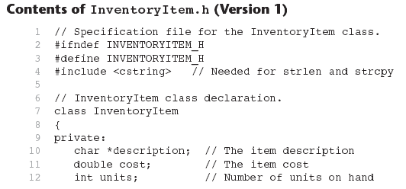

Slide 52
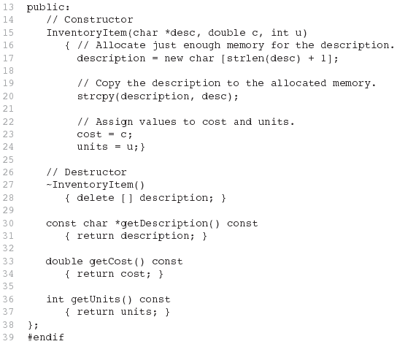
Contents of InventoryItem.h Version1
(continued)

Slide 53
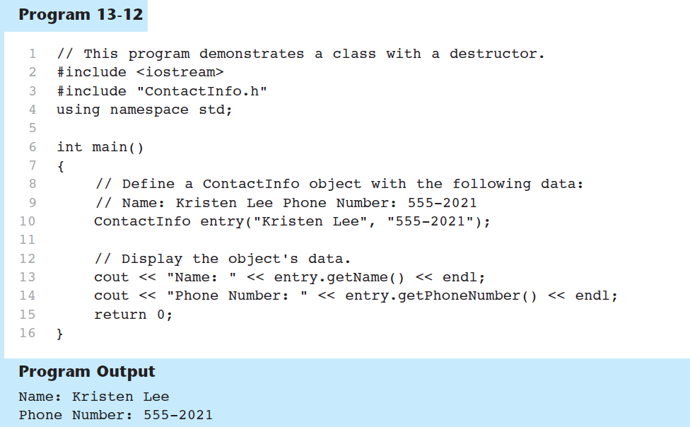

Slide 54
Constructors, Destructors, and Dynamically Allocated Objects
When an object is dynamically allocated with the new operator, its constructor executes:
Rectangle *r = new Rectangle(10, 20);
When the object is destroyed, its destructor executes:
delete r;

Slide 55
13.10
Overloading Constructors

Slide 56
Overloading Constructors
A class can have more than one constructor
Overloaded constructors in a class must have different parameter lists:
  Rectangle();
  Rectangle(double);
  Rectangle(double, double);

Slide 57
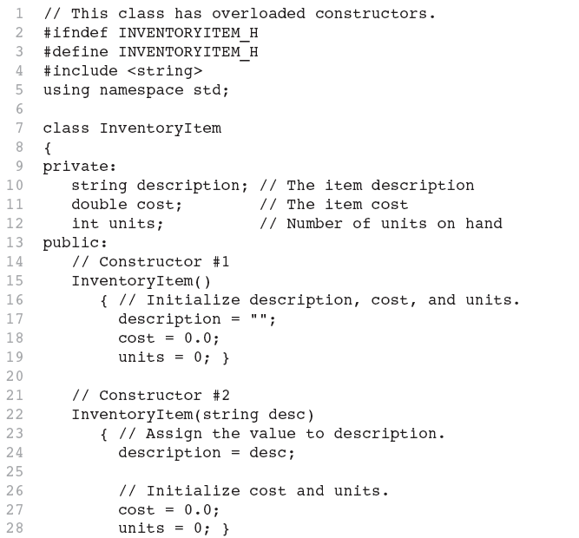
Continues...

Slide 58
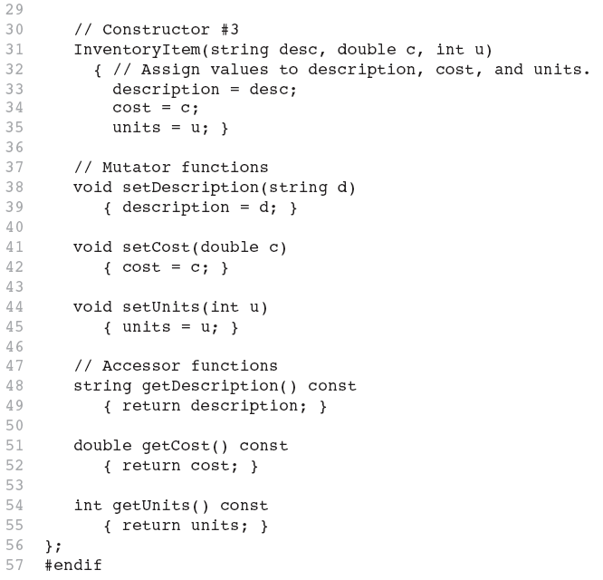

Slide 59
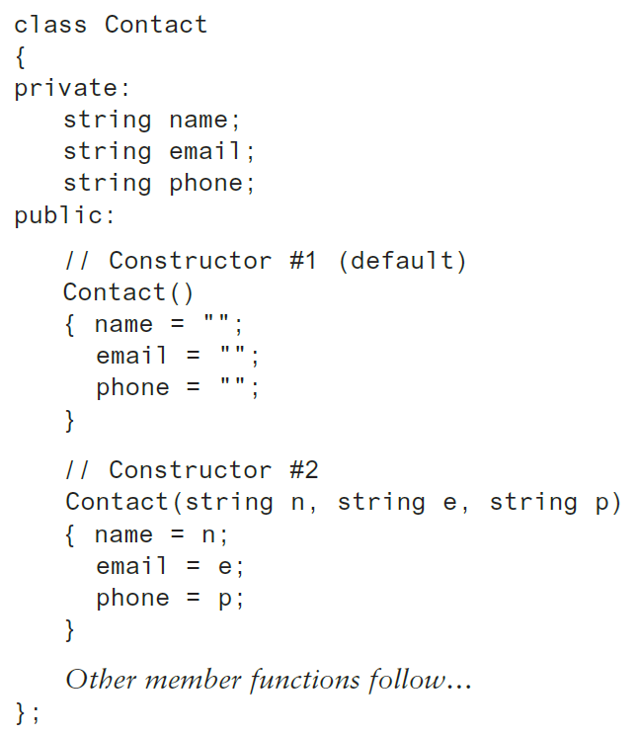
Constructor Delegation
Sometimes a class will have multiple constructors that perform a similar set of steps. For example, look at the following Contact class:

Slide 60
Constructor Delegation
Both constructors perform a similar operation: They assign values to the name, email, and phone member variables.
The default constructor assigns empty strings to the members, and the parameterized constructor assigns specified values to the members.

Slide 61
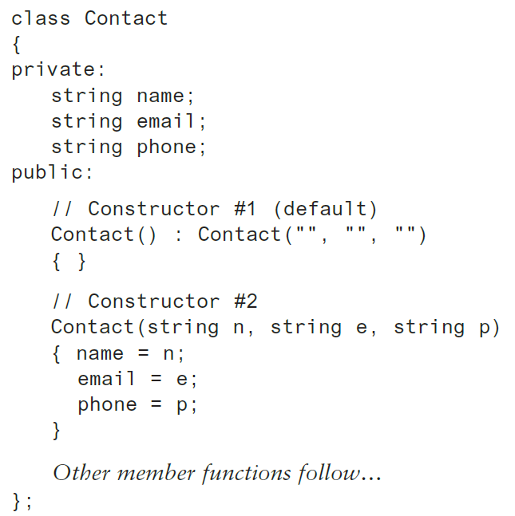
Constructor Delegation
In C++ 11, it is possible for one constructor to call another constructor in the same class.
This is known as constructor delegation.

Slide 62
Only One Default Constructor and One Destructor
Do not provide more than one default constructor for a class: one that takes no arguments and one that has default arguments for all parameters
  Square();
  Square(int = 0); // will not compile
Since a destructor takes no arguments, there can only be one destructor for a class

Slide 63
Member Function Overloading
Non-constructor member functions can also be overloaded:
  void setCost(double);
  void setCost(char *);
Must have unique parameter lists as for constructors

Slide 64
13.11
Using Private Member Functions

Slide 65
Using Private Member Functions
A private member function can only be called by another member function
It is used for internal processing by the class, not for use outside of the class
See the createDescription function in ContactInfo.h (Version 2)

Slide 66
13.12
Arrays of Objects

Slide 67
Arrays of Objects
Objects can be the elements of an array:
  InventoryItem inventory[40];
Default constructor for object is used when array is defined

Slide 68
Arrays of Objects
Must use initializer list to invoke constructor that takes arguments:
  InventoryItem inventory[3] =
  { "Hammer", "Wrench", "Pliers" };

Slide 69

Arrays of Objects
If the constructor requires more than one argument, the initializer must take the form of a function call:

Slide 70

Arrays of Objects
It isn't necessary to call the same constructor for each object in an array:

Slide 71
Accessing Objects in an Array
Objects in an array are referenced using subscripts
Member functions are referenced using dot notation:
  inventory[2].setUnits(30);
  cout << inventory[2].getUnits();

Slide 72
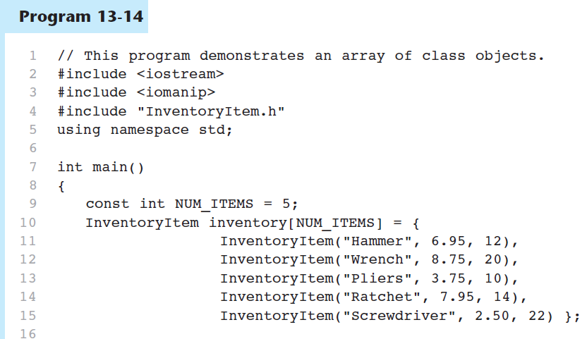

Slide 73
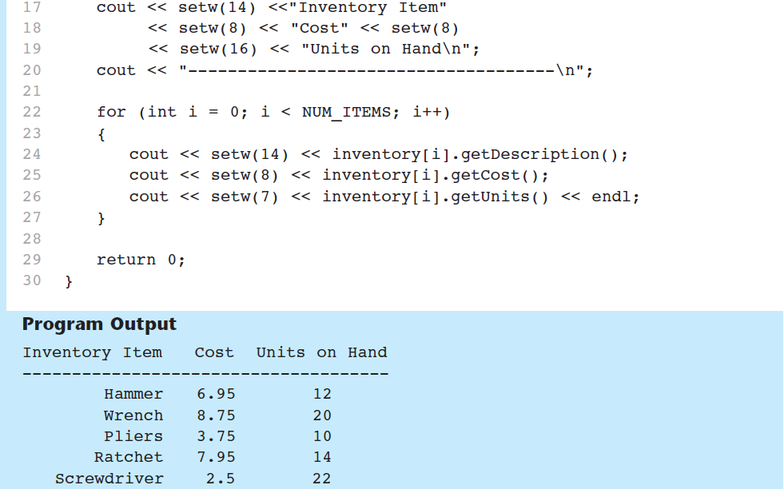
Program 13-14 (Continued)

Slide 74
13.16
The Unified Modeling Language

Slide 75
The Unified Modeling Language
UML stands for Unified Modeling Language.
The UML provides a set of standard diagrams for graphically depicting object-oriented systems

Slide 76
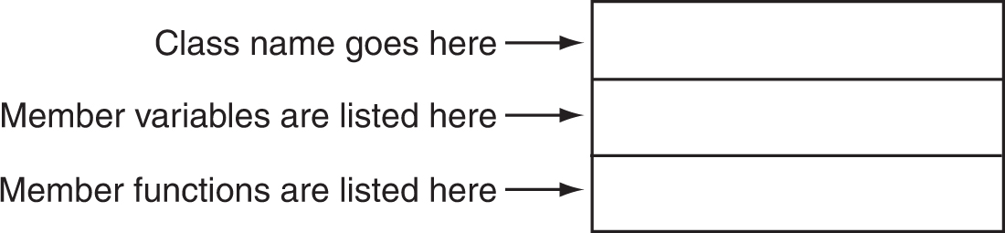
UML Class Diagram
A UML diagram for a class has three main sections.

Slide 77
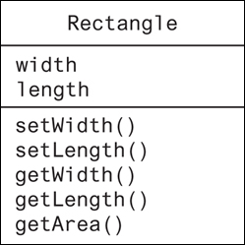
Example: A Rectangle Class
class Rectangle
{
private:
double width;
double length;
public:
bool setWidth(double);
bool setLength(double);
double getWidth() const;
double getLength() const;
double getArea() const;
};

Slide 78
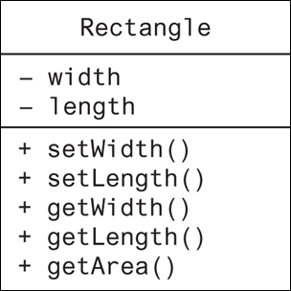
UML Access Specification Notation
In UML you indicate a private member with a minus (-) and a public member with a plus(+).
These member variables are private.
These member functions are public.

Slide 79
UML Data Type Notation
To indicate the data type of a member variable, place a colon followed by the name of the data type after the name of the variable.
- width : double
- length : double

Slide 80
UML Parameter Type Notation
To indicate the data type of a function’s parameter variable, place a colon followed by the name of the data type after the name of the variable.
+ setWidth(w : double)

Slide 81
UML Function Return Type Notation
To indicate the data type of a function’s return value, place a colon followed by the name of the data type after the function’s parameter list.
+ setWidth(w : double) : void

Slide 82
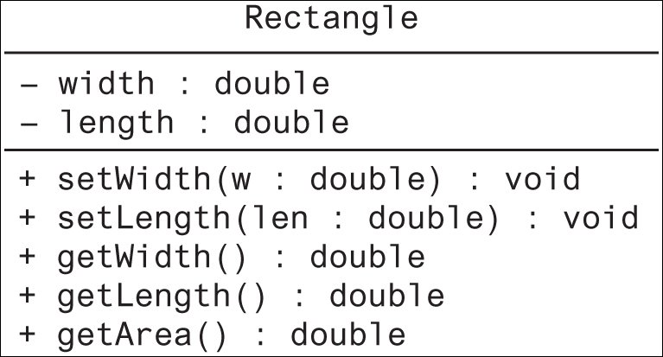
The Rectangle Class

Slide 83
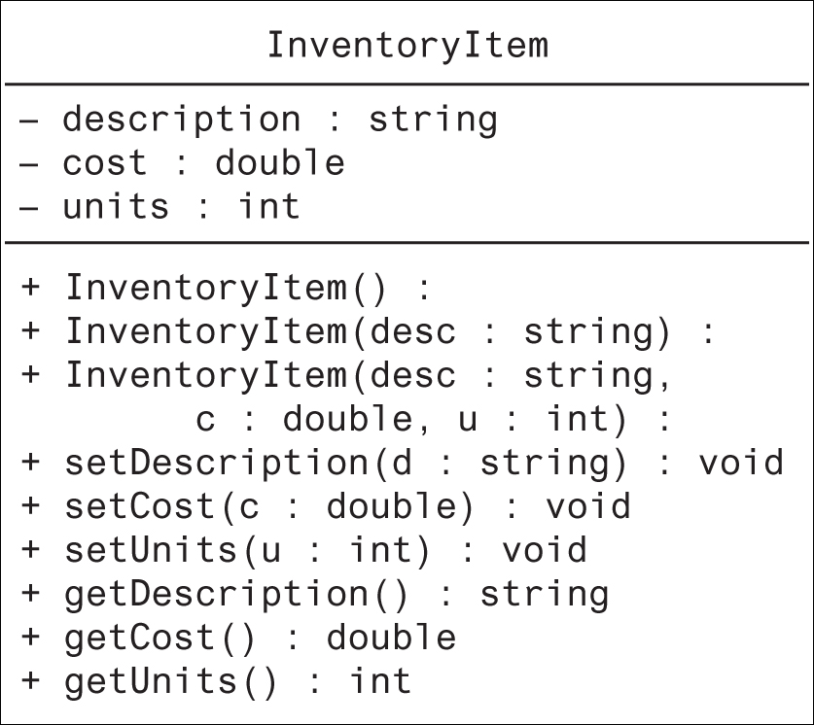
Showing Constructors and Destructors
No return type listed for constructors or destructors
Constructors
Destructor

Slide 84

Copyright
This work is protected by United States copyright laws and is provided solely
for the use of instructions in teaching their courses and assessing student
learning. dissemination or sale of any part of this work (including on the
World Wide Web) will destroy the integrity of the work and is not permit-
ted. The work and materials from it should never be made available to
students except by instructors using the accompanying text in their
classes. All recipients of this work are expected to abide by these
restrictions and to honor the intended pedagogical purposes and the needs of
other instructors who rely on these materials.

